Slide 1

Full Stack Development
PRAVEEN N
ARUL VALAN CIBI

Slide 2

What is Full Stack?
Full Stack Web Developer
A full stack web developer is a person who can develop both client and server software.
These developers aren't expert in everything but simply have the functional knowledge to finish and develop the entire product.
Frontend
Backend
Frontend
Backend

Slide 3
Layers in Full Stack Development
Client Side code
Browser
Server Side Code
Webserver
Database

Slide 4



Layers in Full Stack Development
Client Side code
Browser
Server Side Code
Webserver
Database
HTML/CSS/JS

Slide 5
Layers in Full Stack Development
Client Side code
Browser
Server Side Code
Webserver
Database
Firefox
Chrome
Brave
Note:
The client can also be a mobile app

Slide 6
Layers in Full Stack Development
Client Side code
Browser
Server Side Code
Webserver
Database
Node Js
JAVA
PHP
Python

Slide 7
Layers in Full Stack Development
Client Side code
Browser
Server Side Code
Webserver
Database
Apache
IIS
NGNIX
Notes:
To host client side code

Slide 8
Layers in Full Stack Development
Client Side code
Browser
Server Side Code
Webserver
Database
Mongo db
Mysql
Postgresql
Microsoft SQL Server
Notes:
There is also different types of database, SQL, No-Sql, Column Store, In-memory, graph db

Slide 9
Layers in Full Stack Development
Client Side code
Browser
Server Side Code
Webserver
Database
React Js
Node JS
File System

Slide 10
Let’s start with React
React is a JavaScript library for building user interfaces.
Why react is needed?
Notes:
In React, you develop your applications by creating reusable components that you can think of as independent Lego blocks

Slide 11
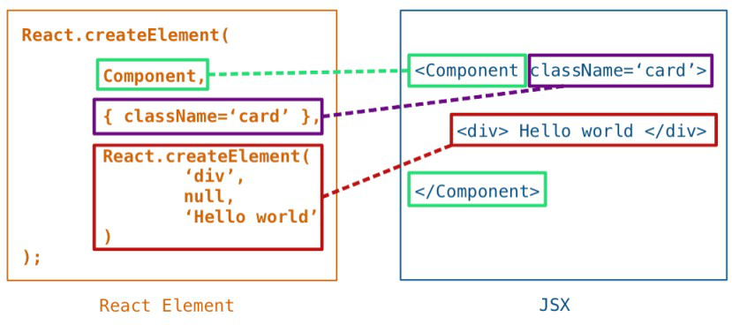
React JSX / React element
What is JSX?
It is Javascript meant to imitate JSX
Minimize the developer effort to define UI structure
Who else use JSX
Vue, Solid js, Preact ...

Slide 12
React 1 Installation
Installation…
Note: Node JS is a dependency
Create react app
npx create-react-app simple-app
cd simple-app
npm start

Slide 13
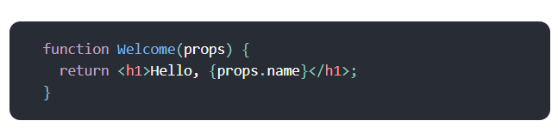
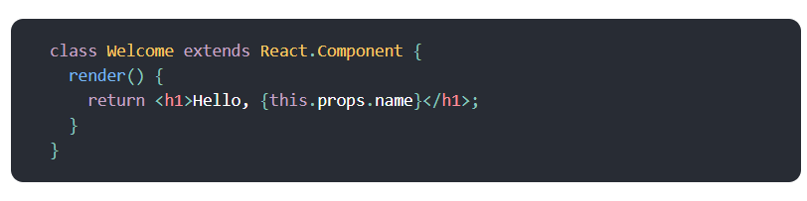
React 2 Components
Types of Components
Functional Component
Class Component
What is a component?
Reusable pieces of UI
Accept arbitrary inputs called Props
Returns React element describing the Html to paint on screen
Notes:
https://react.dev/learn

Slide 14
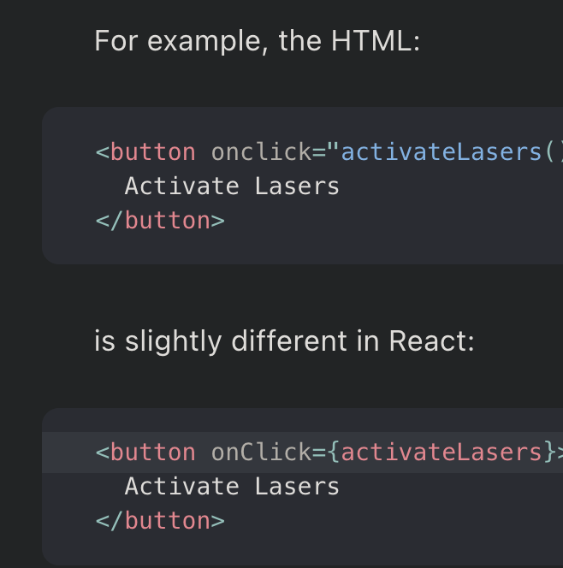
React 3 Handling Events
How to attach event to the components?
React events are named using camelCase, rather than lowercase.
With JSX you pass a function as the event handler, rather than a string.
Notes:
Handling events with React elements is very similar to handling events on DOM elements. There are some syntax differences.
https://legacy.reactjs.org/docs/handling-events.html

Slide 15
React 4 State
What Is 'State' in ReactJS?
A component's memory.
A component's state can change over time
Whenever state changes, the component re-renders.
Ex: CounterApp
Notes:
https://react.dev/learn

Slide 16
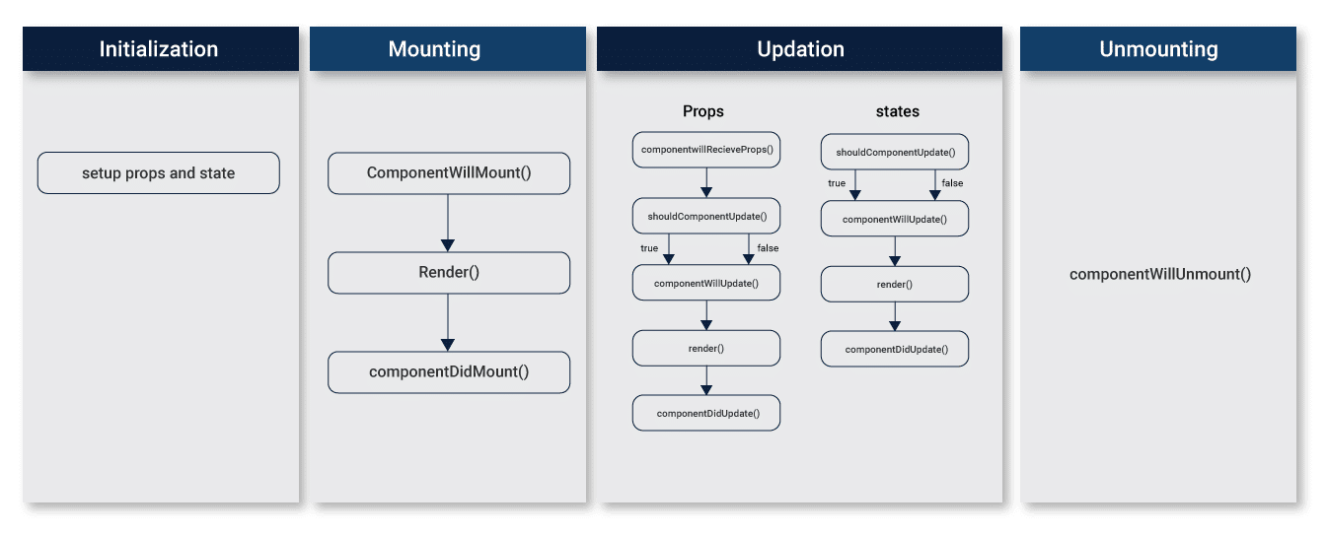
React 5 LifeCycle methods
Constructor()
Notes:
https://react.dev/learn

Slide 17
React Hooks
UseState()
The state hook
UseEffect()
The side effect hook
Eg: Odd or even app
Notes:
Arul will handle this

Slide 18
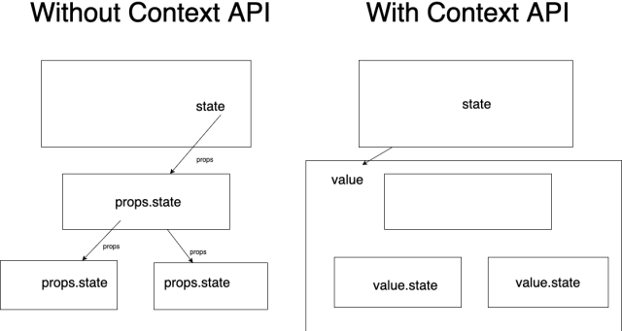
React Context
Provides a way to avoid props drilling into the component tree
Example: Context sandbox
Notes:
Arul will handle this

Slide 19
NodeJS
Node.js is a back-end JavaScript runtime environment, runs on the V8 JavaScript Engine, and executes JavaScript code outside a web browser.

Slide 20
Node 1
Installation..
npm init
Simple node JS code

Slide 21
CRUD - API
Create - POST
Update - PATCH
Read - GET
Delete -DELETE
Notes:
What is API

Slide 22
Express
Express JS is a Node.js framework designed to build API's web applications cross-platform mobile apps quickly and make node js easy.
Installation..

Slide 23
Simple Get and React integration
Simple GET API – route
Fetch it from React
Display it in React app

Slide 24

fetch()
The global fetch() method starts the process of fetching a resource from the network, returning a promise which is fulfilled once the response is available.
The promise resolves to the Response object representing the response to your request.

Slide 25
Using file as DB
Simple form example on using file as DB
Insert value to file
Get Value from file

Slide 26

Questions ?

Slide 27

Thank You
Praveen N Linked In - linkedin.com/in/np77
Twitter - @np_hinata
Arul Valan Cibi
GitHub repo link https://github.com/praveenn77/workshop-w1

